Slide 1

On Angel Investing
A Capstone study for Springboard
cc: angermann - https://www.flickr.com/photos/44124395142@N01

Slide 2
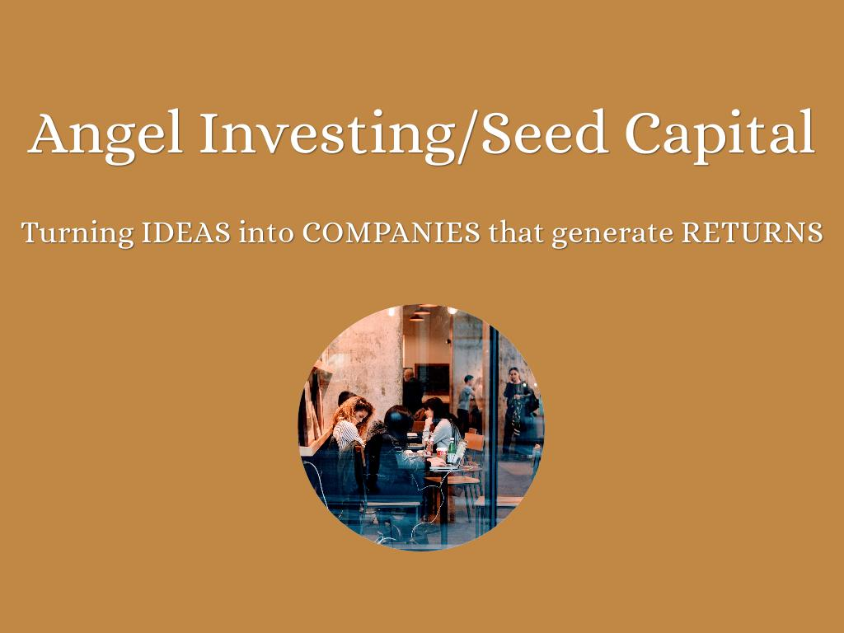

Slide 3
What DO Angel returns look like?
Lack of public data in this field
Company characteristics are difficult to capture
Crunchbase data (2007 - 2014) as a starting point
Identify areas for further study

Slide 4

Populous data (19k x 18) informs broad conclusions Tiny sample (90 x 10) on which to build inferences Data quality at work

Slide 5
General Conlusions
Companies based in SF & NY are more likely to be acquired
More funding -> more likely to be acquired
Too much funding inhibits returns
Longer horizon -> better visibility

Slide 6


Slide 7
Missing Data & Assumptions
350 companies missing pricing data
Returns should resemble the distribution of knowns
& also result in feasible price outcomes
Returns conclusions are extremely sensitive to these assumptions

Slide 8

Returns in this space are terrible Of the $4.9Bn invested in 2007, only $2.8Bn in capital had been returned by 2014 20% IRR expectations are unrealistic

Slide 9
Granted
"Informed Investors" can likely do better
One big acquisition is all it takes
No value assigned to companies that remained operating in 2014
Obvious data quality issues could give false impression

Slide 10


Slide 11
Thank You
cc: angermann - https://www.flickr.com/photos/44124395142@N01

